Slide 1
Parcel Management System

Slide 2
Introduction
Parcel Management System is a web-based software application developed to manage parcel booking, billing, customer information, and parcel tracking in a digital and efficient manner.
The software is designed to simplify daily parcel operations such as customer registration, parcel entry, bill generation, and parcel status management.
This system helps parcel offices and courier services to maintain records electronically instead of using manual paper-based methods
Parcel Management System is a web-based application used to manage parcel booking, billing, and customer records digitally. It reduces manual work, improves efficiency, and helps in fast and accurate parcel management.

Slide 3
Problem Statement
1.Manual Record Keeping
All parcel and billing details were maintained on paper, which was time-consuming and difficult to manage.
2.Data Loss Risk
Paper records could be lost, damaged, or misplaced easily.
3.Billing Errors
Manual bill calculation caused mistakes in total amount, weight charges, and payments.
4.Duplicate Entries
Same customer or parcel data could be entered multiple times.

Slide 4
Problems Solved
1.Digital Record Management All parcel, customer, and billing data is stored digitally in database.
2.Reduced Data Loss Data is safely stored in MySQL database, reducing risk of loss.
3.Parcel Tracking Feature Parcel status can be updated and tracked easily.
4.Better Data Management Duplicate entries are reduced and records are well-organized.

Slide 5
Very Short Version
Problems
Solutions
Manual paperwork
Billing mistakes
Slow record search
No tracking system
Digital database
Automatic billing
Fast record access
Parcel tracking system

Slide 6
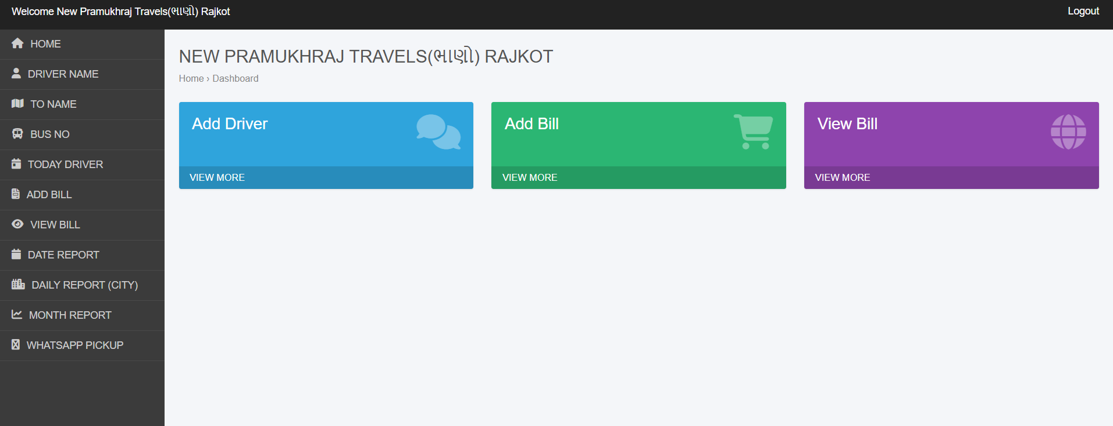
DashBord

Slide 7
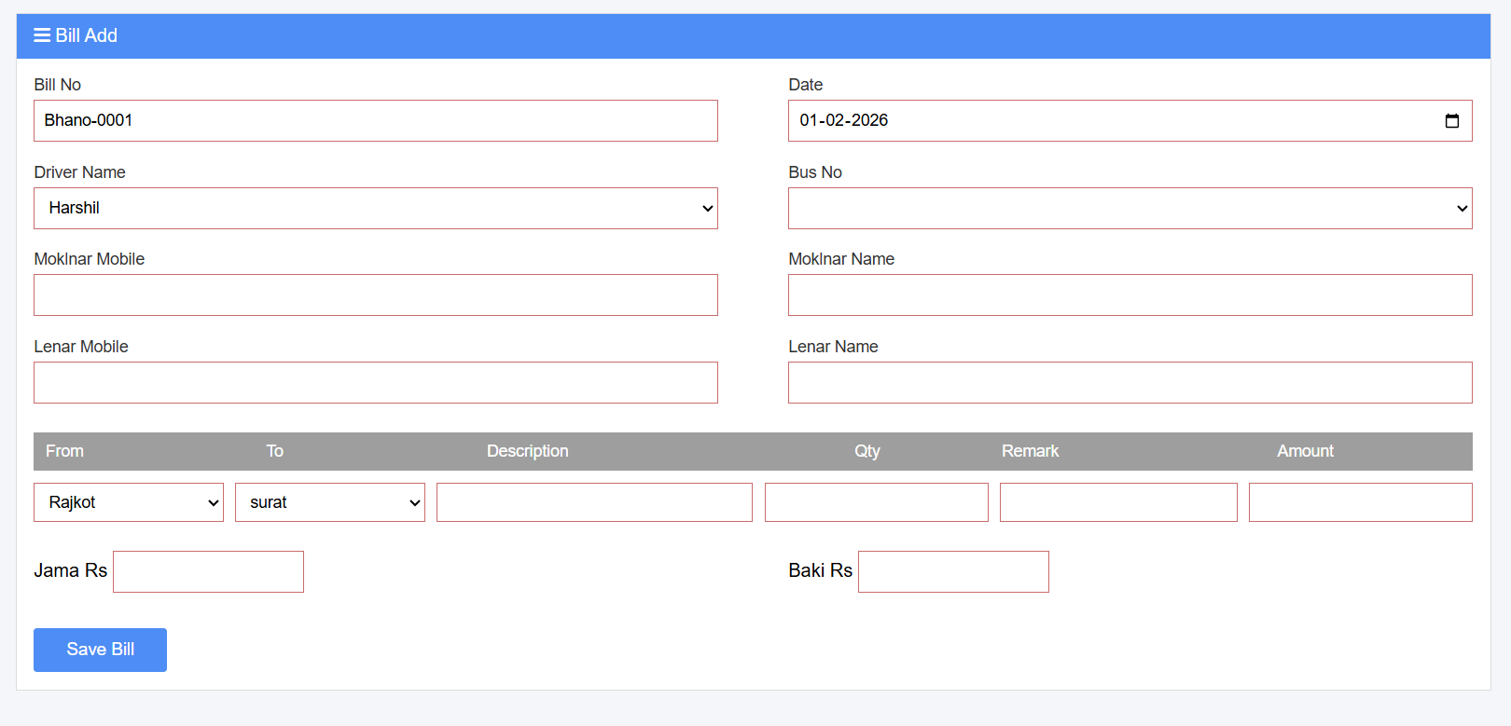
Add Bill

Slide 8
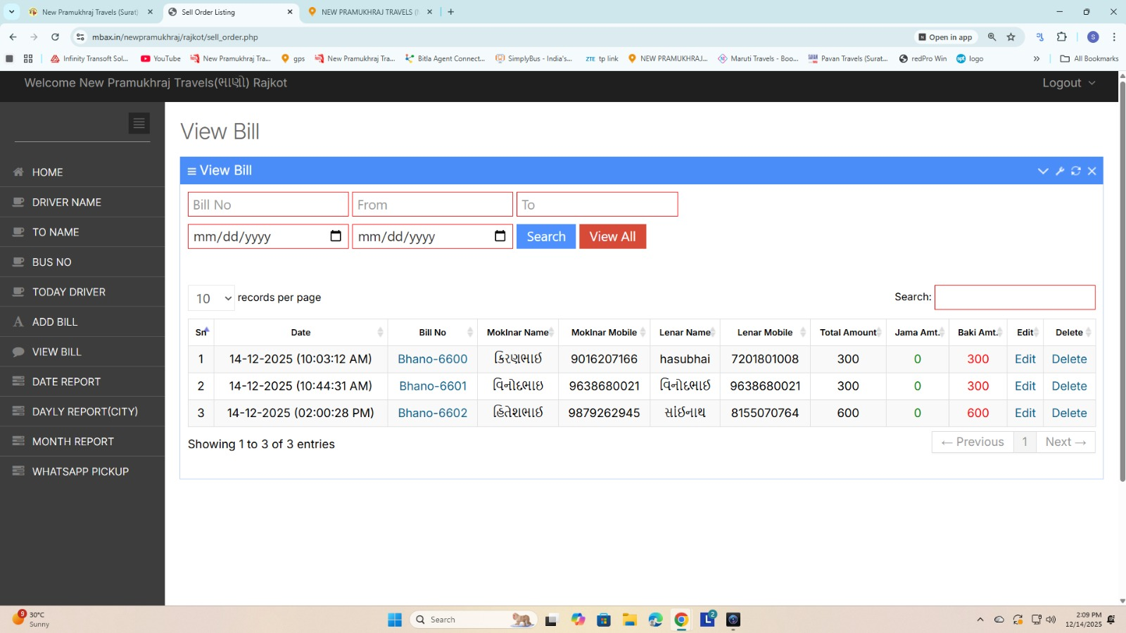
View Bill

Slide 9
Working of Parcel Management System
The Parcel Management System is a web-based application that works on a client-server architecture. The user accesses the system through a web browser, and all data is processed and stored on the server using PHP and MySQL database.
1.User Login
The user logs into the system using valid username and password. The system verifies user credentials from the database.
2.Dashboard Access
After successful login, the user is redirected to the dashboard, where all system modules are available.

Slide 10
3.Customer Registration
The user adds customer details such as name, contact number, and address. The data is saved in the customer database table.
4.Parcel Booking
The user enters parcel information including sender, receiver, parcel weight, parcel type, and destination. The system calculates charges based on weight and stores parcel details in the database.
5.Bills List Management
All generated bills are displayed in the Bills List page (URL: /parcel-app/bills/list.php). The user can view, search, and manage previous bills.
6.Parcel Tracking & Status Update
The system allows updating parcel delivery status such as Booked, In Transit, and Delivered.

Slide 11
7.Database Storage
All customer, parcel, bill, and payment data is stored securely in the MySQL database.
->Short Working
User logs in → Adds customer → Books parcel → System calculates charges → Bill is generated → Bill stored in database → Bills can be vie
wed in Bills List → Payment and parcel status updated.

Slide 12
Features Used in Parcel Management System
1.User Login and Authentication
2.Customer Information Management
3.Parcel Booking System
4.Sender and Receiver Details Management
4.Automatic Parcel Charges Calculation
5.Bill Generation System
6.Bills List and Record Management
7.Search and View Previous Bills
8.Payment Status Management

Slide 13
9.Parcel Delivery Status Update
10.Centralized Database Storage (MySQL)
11.Web-Based User Interface
12.Validation and Error Handling
13.Role-Based Access Control (if implemented)
14.Secure Session Management
15.CRUD Operations (Create, Read, Update, Delete)
16.Report Viewing (if available)
17.User-Friendly Dashboard
18.Record Backup Support (if configured)
19.Multi-User Support

Slide 14
Thank You, Thank You for Your Attention Parcel Management System Software Documentation Presentation.

